Slide 1

Front-end design patterns and architecture
What is front-end?
Special challenges of the frontend
Architectural patterns for the front-end
Coding
HTML architecture
CSS architecture
Javascript architecture
Processes and testing
Documentation
Design patterns of significance
Cisco CHN09 TechTalk – Aug 19, 2021 Sharan Selvaraj

Slide 2


What is the front-end?
Client-facing application, which could possible run on the client’s system extensively
Web technologies (i.e., HTML, CSS, DOM, and JavaScript), which run on the Open Web Platform or act as compilation input for non-web platform environments (i.e., React Native)

Slide 3
Special challenges of the frontend
Browser compatibility and operating system compatibility [cross-browser, cross-platform and cross-device]
Language limitation - JS is the language of the browser, with HTML for templating and CSS for styling
Performance while running in a browser
Network limitations and performance despite it
Asynchronous and Reactive
State management – Increasingly complicated UI
Easy JS solution VS the right solution for the long-term, especially considering the nature of JS
Other challenges - SEO (with SPAs), changing standards, obfuscation, security

Slide 4
Architectural patterns for the front-end
Coding - HTML architecture
Declarative VS imperative programming styles for modifying the DOM
Client Vs Server-side rendering
Coding - CSS architecture
CSS in JS
Inverted triangle CSS
CSS preprocessors. …..
Coding - Javascript/Typescript architecture
JavaScript Modules / Lazy-loading
DOM Diffing & Patching
Asyncronous programming
Routing
State management
Micro Frontends …..
Short overview
Fundamental structures of a software system
The architecture of a software system is a metaphor, analogous to the architecture of a building
Blueprint for the system

Slide 5
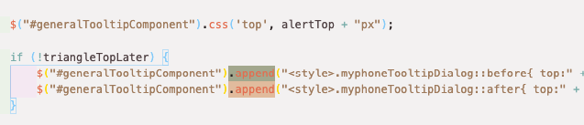
HTML architecture - Declarative VS imperative programming styles for modifying the DOM
Declarative programming is when you say what you want, and imperative language is when you say how to get what you want; Power VS robustness
Declarative style – HTML Templates in Angular
Imperative style – Jquery

Slide 6
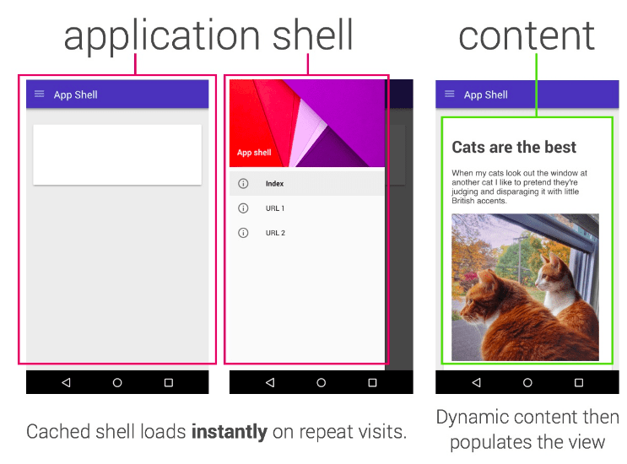
HTML architecture - Client Vs Server-side rendering
Client-Side
DOM and styling is not available at app load, only rendering logic is fetched
Code fetched renders the UI
Pros
Faster switching after initial load and interactivity
Angular SPAa
Server-side rendering
HTML structure and styling completely rendered in the server and sent to client
Pros:
Facilitate web crawlers through search engine optimization (SEO)
Improve performance on mobile and low-powered devices
Show the first page quickly with a first-contentful paint (FCP)
RialtoMarket app (A little dynamic too due to JQuery)
Templating used for serving pages.
Hybrid / Isomorphic rendering
https://developers.google.com/web/fundamentals/architecture/app-shell
Scenario
End-User of a Webex Calling app, travelling between towns, suddenly wants to send over the history of last dialed numbers to another person, and the app is super-slow to load given a slower internet.
Heavy app that takes time to load
Angular – Universal (https://angular.io/guide/universal )
Render the shell of the application completely in the server and allow the client to load the rest
https://angular.io/guide/app-shell

Slide 7
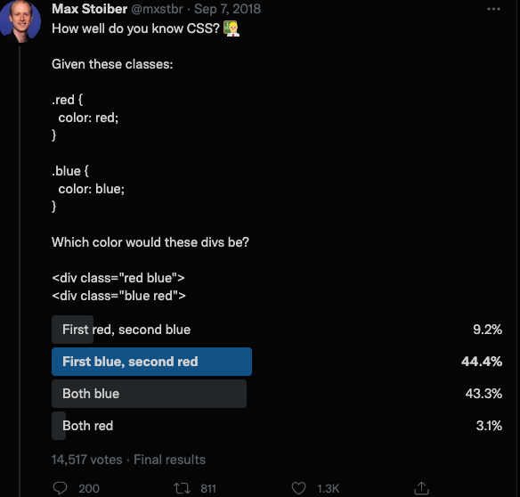
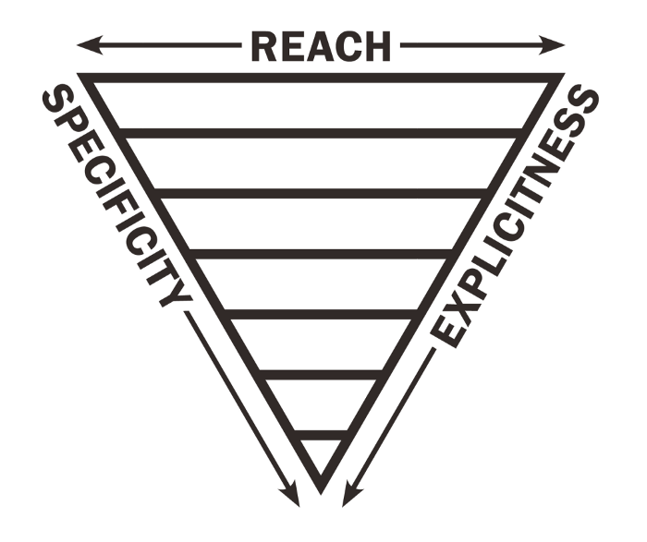
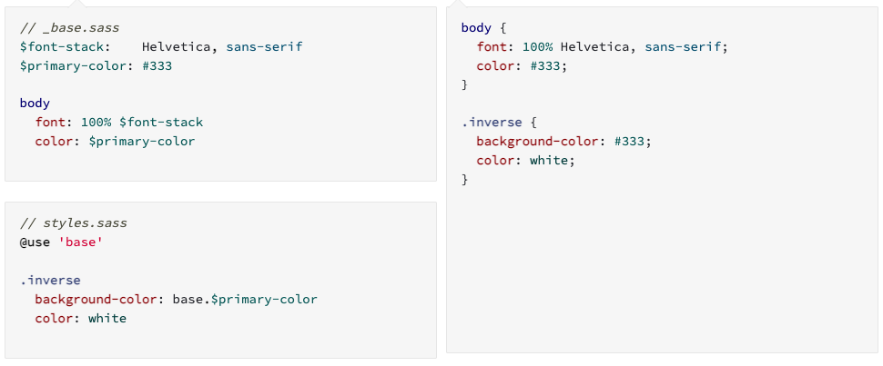
CSS architecture
CSS in JS
Encapsulation of CSS closely with your JS components
Hard to get out of off once into, also to move to another platform or framework
Great for easily sharing components and not worrying about CSS confusions
Angular CSS files
Inverted triangle CSS / ITCSS
Shared CSS, but using patterns for separation of widely-affected VS less-affected styles
Utility-first CSS
Utility classes for various styles, and could possibly use CSS frameworks like tailwind for applying them
ITCSS compatible
CSS pre-processors – SASS, Stylus etc
CSS Modules
Not a standard officially, but can be achieved using web-pack or SASS etc
https://twitter.com/mxstbr/status/1038073603311448064?lang=en
Modules - https://sass-lang.com/guide

Slide 8
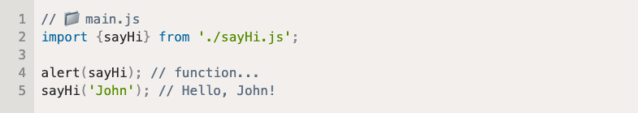
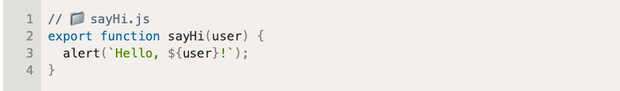
JavaScript architecture – Modules and loading types
Modules
Decoupling, Encapsulation, Performance
Lots of ways to achieve it
CommonJS and AMD-based, ES2015 modules
Synchronous / Asynchronous
Webpack, browserify / RequireJS, Dojo
Scenario
Replicate a multi-selection element which is a form input in another view in your app, given that this one is currently not in its own module/comp
Always have it in a replicable fashion and separated
What to consider
Server-side JS vs Client-side JS
Order , Asynchronous, browser-support (ES2015 is not supported in IE)
Loading VS Bundling
Lazy loading
Angular loading mechanisms
Eager / Lazy and preload
Critical rendering path – Time taken for building the DOM and first-view being painted.
CSSOM – Media queries while attaching CSS, preload attribute
Blocking JS scripts, which can be changed to Async scripts (Analytics scripts for example), using defer, JS modules

Slide 9
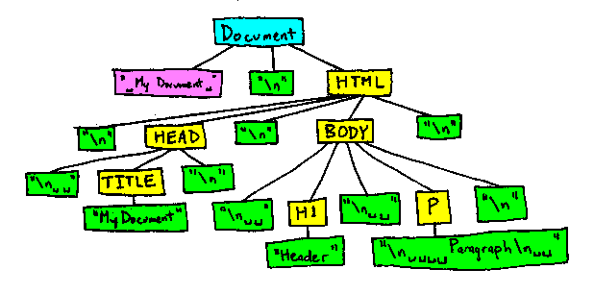
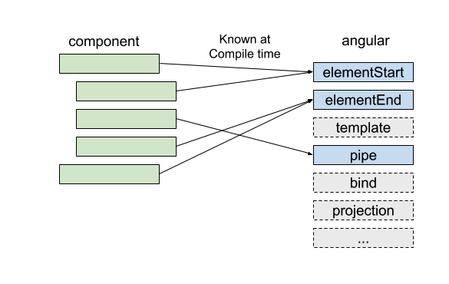
DOM Diffing & Patching
Change detections and DOM re-rendering
Front-end frameworks greatly help with this - various methods adopted
Famous ones
React’s VDOM, Angular’s ZoneJS-based change detection
Angular Ivy – Incremental DOM
Lots of methods
Incremental DOM
Ember’s Glimmer
Factors to consider
Device / memory foot print. VDOM for a large app can consume memory
Tree-Shakeable nature
Angular's Incremental DOM - Ivy

Slide 10
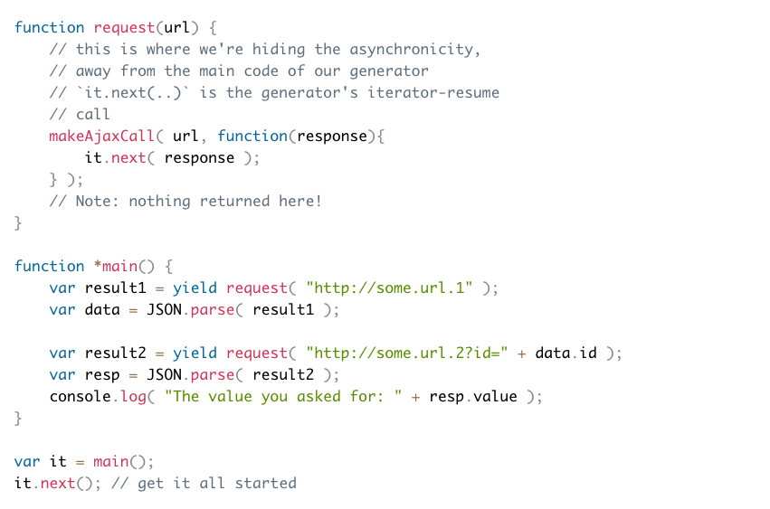
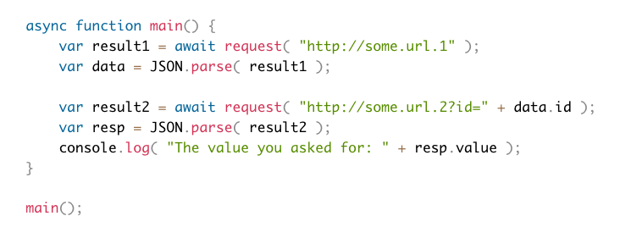
Asyncronous programming
Normal functions are synchronous: the caller waits until the callee is finished with its computation
Asynchronous programming makes it possible to express waiting for long-running actions without freezing the program during these actions.
Callbacks, functions that are called when the actions complete.
Callback-hell
Modern syntax
Promises
Call still become complicated to read and understand
Generators
Async/Await
Browser support – Babel
Reactive programming - Streams of data, operations, subscriptions
RxJS observables
Delayed execution (Eager VS lazy)
Multicast, Multiple streams to be handled (race)
Operations
Courtersy – https://davidwalsh.name/async-generators

Slide 11

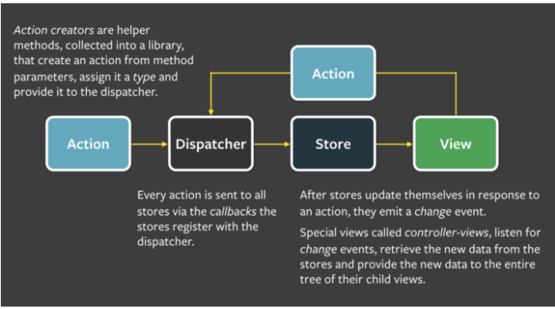
State management
State management refers to the management of the state of one or more user interface controls such as text fields, OK buttons, radio buttons, etc. in a graphical user interface.
Handling how that data is synced, shared and updated is what state management is about
Data/Events translated into UI
Jquery / Direct DOM manipulation based on event handlers or AJAX responses, Asynchronous functions being completed.
Using Models or Store
Multiple models / state stored across multiple objects / components / MV* patterns
Backbone Models
Simple Angular Components
Separation of concerns, Much easier to get started with
Single model or store / Flux pattern
Redux / NgRx
Learning curve and implementation complexity
Courtesy: Wikipedia
Courtesy: https://madasamy.medium.com/flux-vs-mvc-design-pattern-de134dfaa12b

Slide 12
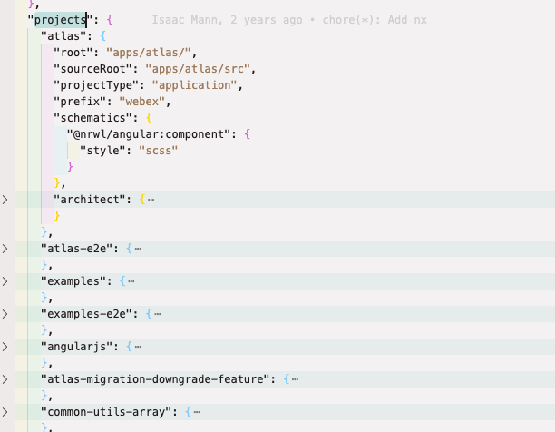
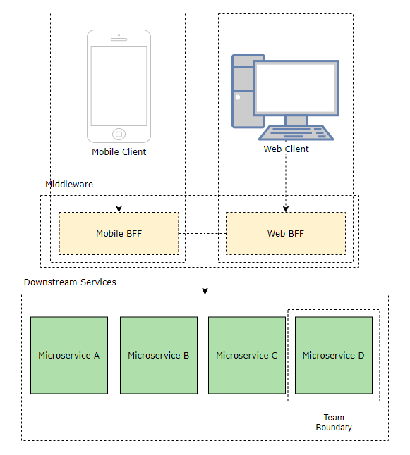
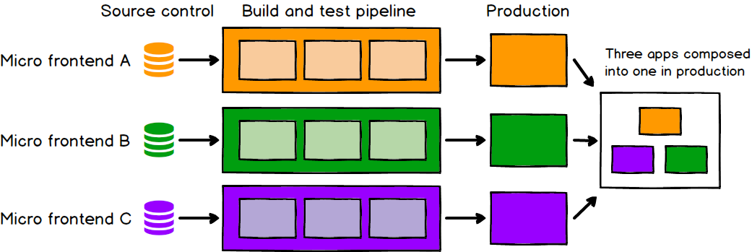
Micro-frontends and Backends for FE
Micro-frontends
smaller, more cohesive and maintainable codebases
more scalable organisations with decoupled, autonomous teams
the ability to upgrade, update, or even rewrite parts of the frontend in a more incremental fashion than was previously possible
Independent deployment
Some cons
Some micro frontend implementations can lead to duplication of dependencies, increasing the number of bytes our users must download. In addition, the dramatic increase in team autonomy can cause fragmentation in the way your teams work.
Backends for FE
Why?
Our server is so bloated. Client-specific control flow is littered everywhere and we are struggling to add features without introducing side effects.
Testing multiple front-ends and facing failure in other front-ends
The BFF applications are lightweight translation layers that decouple individual clients from downstream services and serve only a single frontend.
CH UI codebase – Multi-project workspace, one way to separate a large application using angular projects
Courtesy: https://medium.com/frontend-at-scale/frontend-architectural-patterns-backend-for-frontend-29679aba886c
Courtesy: https://martinfowler.com/articles/micro-frontends.html

Slide 13
Some other bits of FE architecture
Processes and Testing
Task runners like GruntJS, Gulp - A JS task runner basically runs commands for you that would otherwise be tedious or impossible. They do things like compile your code from SCSS to CSS or TypeScript to JavaScript.
Test runners and Testing frameworks for unit testing and E2E testing – Karma, Jest, Cypress etc
Documentation
Why? – Increasingly complicated FE codebase
Static documentation tools
JSDoc
ESDoc
Docz
Hologram / SASSDoc

Slide 14
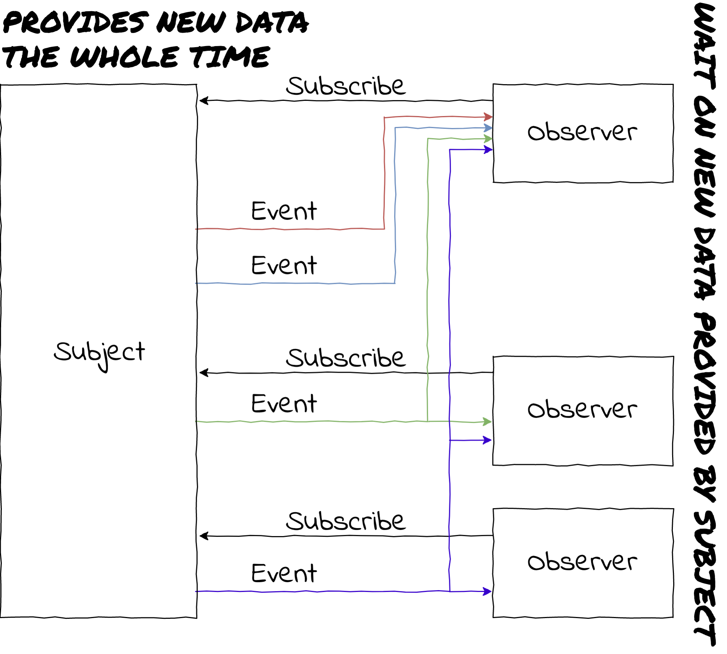
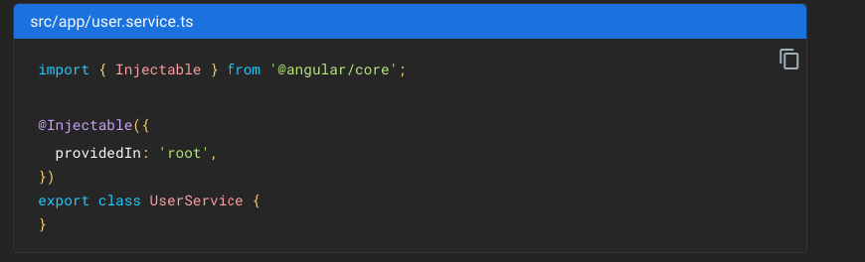
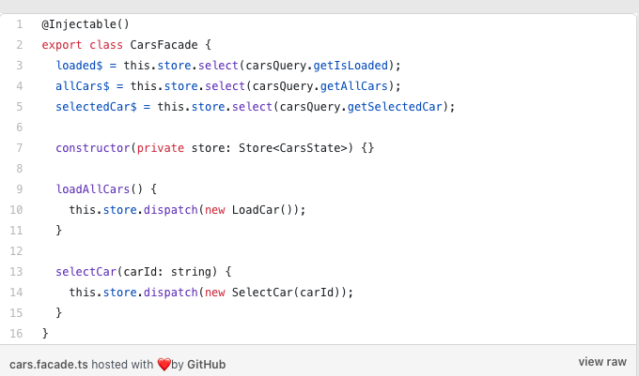
Design patterns of significance
Observer pattern - Courtesy: https://levelup.gitconnected.com/design-patterns-in-modern-javascript-development-ec84d8be06ca
Some significant design patterns
Singleton pattern
Angular’s services
Observer pattern
RxJS
Façade pattern
NgRx Facades
Jquery common lseectors
Singleton pattern - Courtesy: https://angular.io/guide/singleton-services
Façade pattern - Courtesy: https://thomasburlesonia.medium.com/

Slide 15
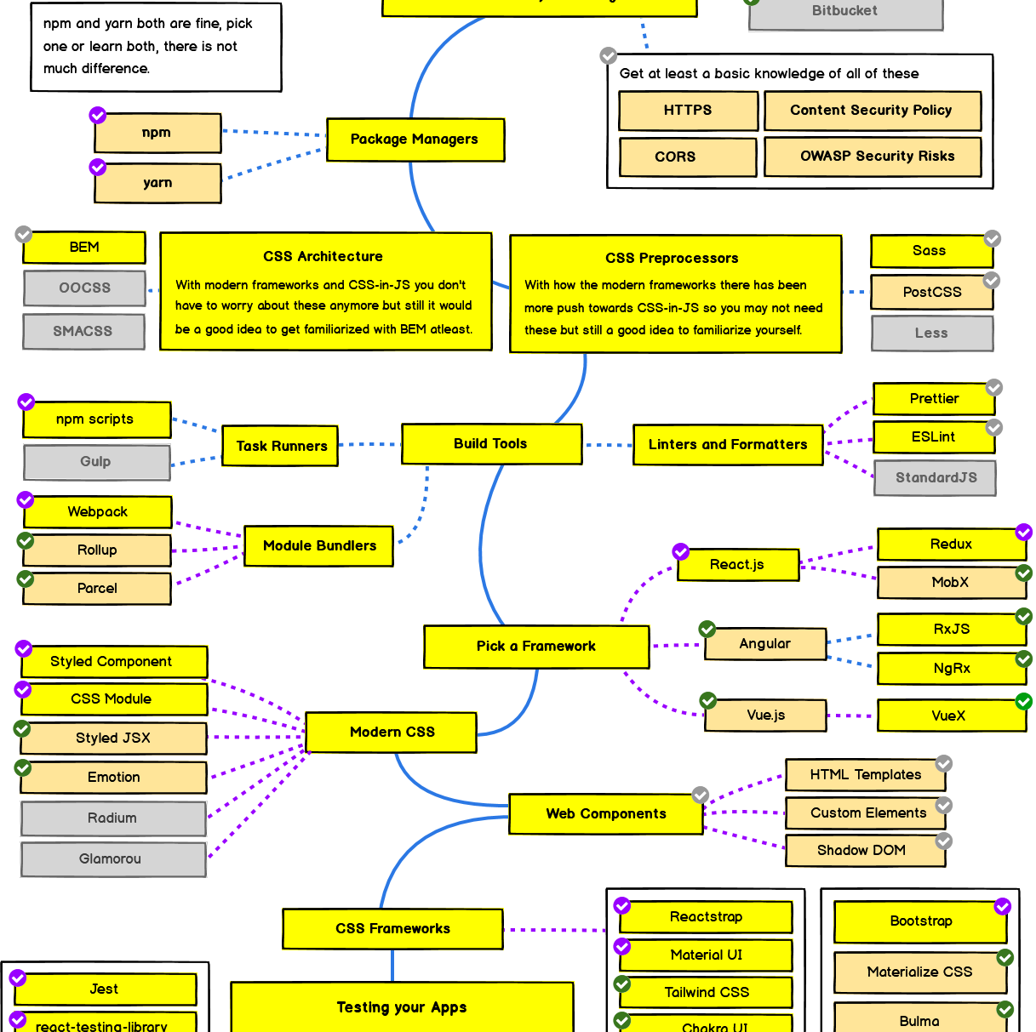
Roadmap for FE dev (Ext. doc)
https://github.com/kamranahmedse/developer-roadmap/blob/master/img/frontend.png?year-2021-2
(https://github.com/kamranahmedse/developer-roadmap)

Slide 16
References
Declarative VS Imperative
https://stackoverflow.com/questions/1784664/what-is-the-difference-between-declarative-and-imperative-paradigm-in-programmin
JS Modules
https://auth0.com/blog/javascript-module-systems-showdown/
https://weblogs.asp.net/dixin/understanding-all-javascript-module-formats-and-tools#webpack-module-bundle-from-cjs-amd-es-modules
Angular loading mechanisms
Eager / Lazy and preload - https://medium.com/@muthudevendra/angular-module-loading-3f9daf77e946
Critical rendering path
https://developer.mozilla.org/en-US/docs/Web/Performance/Critical_rendering_path
https://codeburst.io/whats-the-crp-of-your-webpage-45ba8f8335cc
https://medium.com/comparethemarket/critical-render-path-optimisation-how-to-increase-your-page-speed-820241a4552f
Change Detection and DOM diffing
https://teropa.info/blog/2015/03/02/change-and-its-detection-in-javascript-frameworks.html
https://indepth.dev/posts/1064/what-every-front-end-developer-should-know-about-change-detection-in-angular-and-react
https://blog.nrwl.io/understanding-angular-ivy-incremental-dom-and-virtual-dom-243be844bf36
https://developers.google.com/web/fundamentals/performance/optimizing-javascript/tree-shaking
https://indepth.dev/posts/1258/a-gentle-introduction-into-tree-shaking-in-angular-ivy
https://stackoverflow.com/questions/40902572/what-is-the-use-of-zone-js-in-angular-2
Asynchronous programming
https://exploringjs.com/impatient-js/ch_async-js.html#a-roadmap-for-asynchronous-programming-in-javascript
https://developer.mozilla.org/en-US/docs/Learn/JavaScript/Asynchronous/Choosing_the_right_approach
https://academind.com/tutorials/callbacks-vs-promises-vs-rxjs-vs-async-awaits/
https://davidwalsh.name/async-generators
https://auth0.com/blog/javascript-promises-vs-rxjs-observables/
State management
https://blog.cloudboost.io/the-state-of-web-applications-3f789a18b810
https://ngrx.io/docs

Slide 17
References
Design patterns and Best practices
https://betterprogramming.pub/javascript-design-patterns-25f0faaaa15
https://levelup.gitconnected.com/design-patterns-in-modern-javascript-development-ec84d8be06ca
https://thomasburlesonia.medium.com/ngrx-facades-better-state-management-82a04b9a1e39
https://blog.webf.zone/contemporary-front-end-architectures-fb5b500b0231
CSS Architecture
https://medium.com/@sedwardscode/css-preprocessors-what-why-how-7bc5a7a564de https://www.freecodecamp.org/news/css-preprocessors/.
https://app.pluralsight.com/course-player?clipId=8794c909-d0de-4332-ad6a-807f088c1990
Micro-FEs
https://martinfowler.com/articles/micro-frontends.html
https://medium.com/bb-tutorials-and-thoughts/how-to-implement-micro-frontend-architecture-with-angular-e6828a0a049c
https://medium.com/bb-tutorials-and-thoughts/6-different-ways-to-implement-micro-frontends-with-angular-298bc8d79f6b
BEs for FEs
https://medium.com/frontend-at-scale/frontend-architectural-patterns-backend-for-frontend-29679aba886c
Task Runners:
https://medium.com/tiny-code-lessons/javascript-task-runners-explained-c4762728bda
Testing
https://medium.com/welldone-software/an-overview-of-javascript-testing-7ce7298b9870
Other materials
https://exploringjs.com/
https://eloquentjavascript.net/
Frondend masters website and handbooks

